Slide 1



Customer
Segmentation
Faiz Ahmad
&
UMER FAROOQ

Slide 2
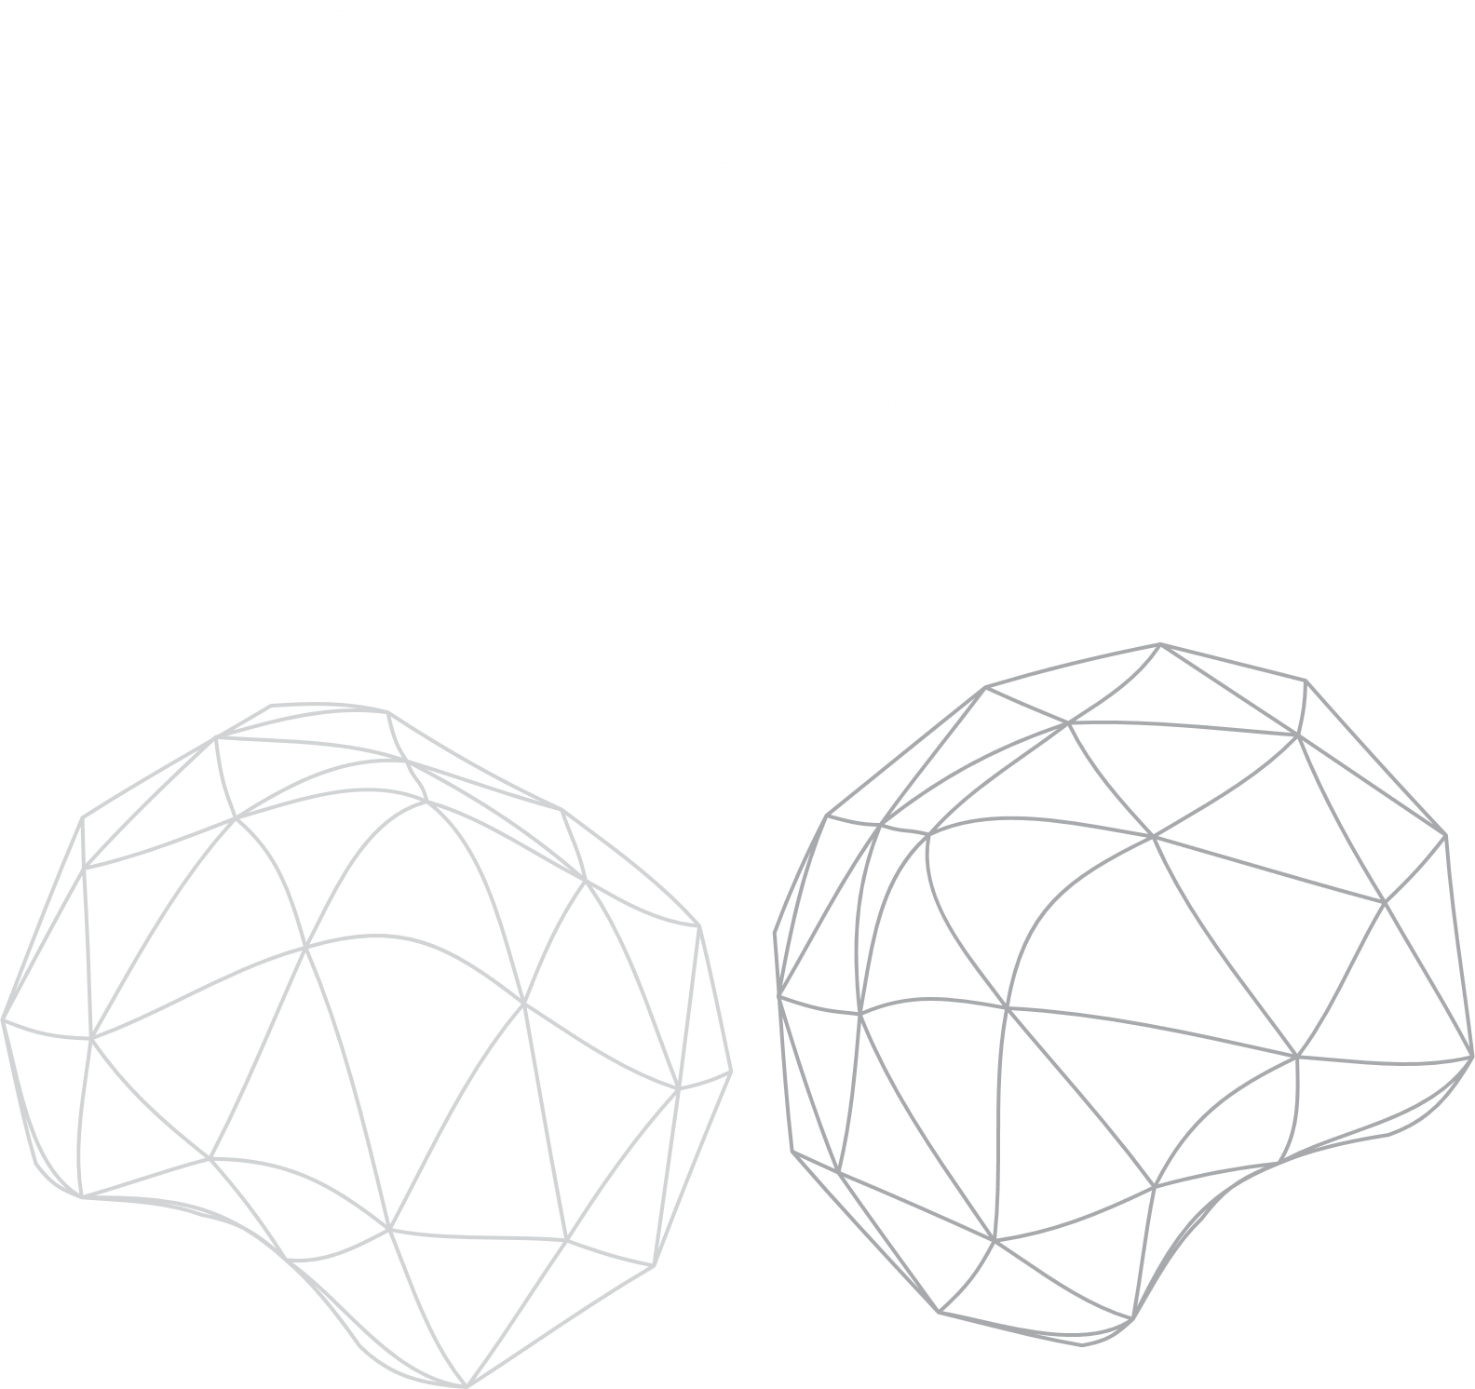
INTRODUCITON
Customer segmentation is a key strategy used in businesses to group customers based on their purchasing behaviors. This allows companies to tailor marketing efforts, improve product recommendations, and enhance customer service strategies.

Slide 3

PROBLEM
Identify high-value customers vs casual shoppers
Improve retention by targeting customers with personalized data
Optimize marketing strategies

Slide 4
Work Flow
Data Featuring
We will categorize customers based on RFM values
Recency (How recently did the customer make a purchase?)
Frequency (How often does the customer make purchases?)
Monetary (How much money has the customer spent?)
And predict which segment a customer belongs to, i.e., High-Value, Churn Risk, Frequent Buyer
Model Development
Normalize the data (because Recency, Frequency, and Monetary have different scales).
Apply K-Means Clustering to group customers into segments.
Label customers as:
High-Value Customers
Frequent Buyers
Churn Risk Customers
One-Time Buyers
Notes:
1️⃣ Recency (R) → How recently did the customer make a purchase?
Feature Calculation:
Find the latest purchase date in the dataset.
Compute the difference between that date and each customer’s last purchase date.
Lower value = more recent purchase (better customer engagement).
2️⃣ Frequency (F) → How often does the customer make purchases?
Feature Calculation:
Count the number of unique invoices (InvoiceNo) per customer.
Higher value = more frequent purchases (loyal customers).
3️⃣ Monetary Value (M) → How much money has the customer spent?
Feature Calculation:
Sum of Quantity × UnitPrice for each customer.
Higher value = high-value customer.

Slide 5

TECH OVERVIEW
Dataset:
Online Retail Dataset
SQL:
for data extraction
Pandas and numpy:
for file handling and manipulation
Scikit learn:
Applying clustering models such as K-means

Slide 6
KEY COMPONENTS
Data Collection
Extracting customer purchase data from SQL databases or CSV files.
Structuring data with attributes like customer ID, transaction date, and purchase amount.
Data Preprocessing
Handling missing values and data inconsistencies.
Transforming transaction data into an RFM table.
Feature Engineering (RFM Analysis)
Recency (R): Days since last purchase.
Frequency (F): Total number of purchases.
Monetary Value (M): Total amount spent.
Clustering Algorithm (Machine Learning)
Applying K-Means clustering or Hierarchical Clustering to group customers.
Evaluating cluster performance using the Elbow Method or Silhouette Score.

Slide 7
Core Features
  Automated Customer Segmentation – Categorizes customers dynamically based on recent purchases, frequency, and spending.
  SQL Integration – Retrieves real-time customer data from structured databases.
  Scalability – Can handle large datasets efficiently.
  Visual Insights – Generates easy-to-interpret graphs and reports.
  Personalized Strategy – Helps businesses target different customer groups with relevant offers.
Notes:
Can handle large datasets efficiently

Slide 8
THANK YOU

